Slide 1
Market Report, April 5
Quant Lab
Hunter Zhang

Slide 2
FactSet Economics Calendar
Date | Country | Statistics | Prior | Consensus | Actual
3/31 | CN | PMI Manufacturing | 49.9 | 49.9 | 50.8
4/1 | US | Retail Sales | 0.70% | 0.30% | -0.20%
4/1 | US | ISM Manufacturing | 54.2 | 54.5 | 55.3
4/3 | US | PMI Services | 54.8 | 54.8 | 55.3
4/4 | DE | Manufacturing Order | -2.1% | 0.50% | -4.2%
01
02
03
04

Slide 3
PMI :
https://www.investopedia.com/terms/p/pmi.asp
Retail Sales:
https://www.investopedia.com/terms/r/retail-sales.asp
ISM Manufacturing:
https://www.instituteforsupplymanagement.org/ISMReport/MfgROB.cfm?SSO=1
1
2
3
4

Slide 4
U.S
U.S. manufacturing rebounds in March, ISM index shows
Trump says U.S-China trade deal may be reached in four weeks
Dow climbs more than 150 points, S&P 500 posts first 6-day winning streak
in over a year

Slide 5
Europe
German manufacturing implosion sends Europe stocks lower
Brexit: EU’s Donald Tusk’s suggests 12-month flexible delay
FTSE clings to six – month high as potential further Brexit delay lifts mood

Slide 6
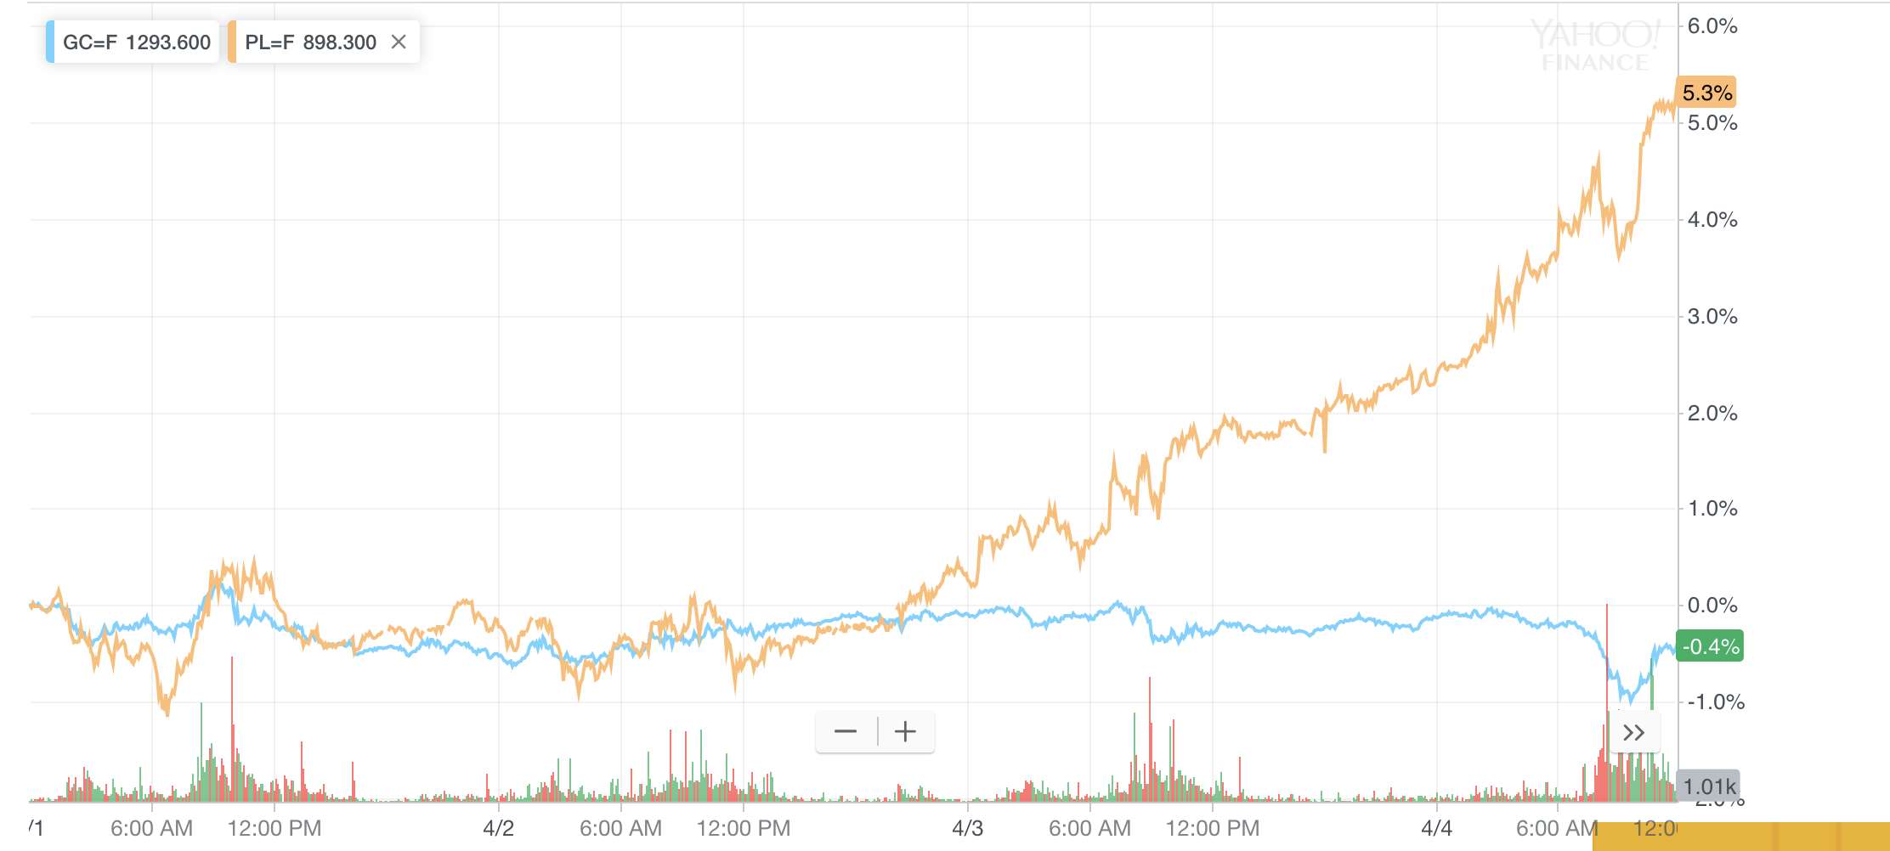
Commodity
“Gold Throws Platinum a Life Line!”

Slide 7
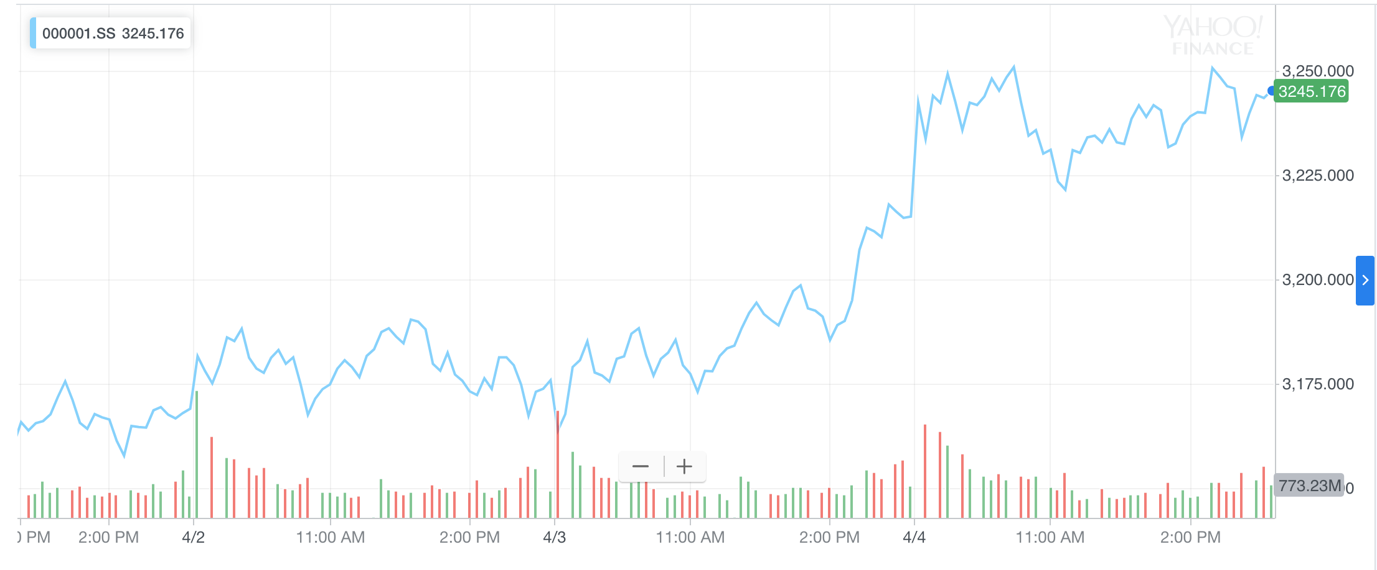
Stock Market Weekly Performance in China

Slide 8
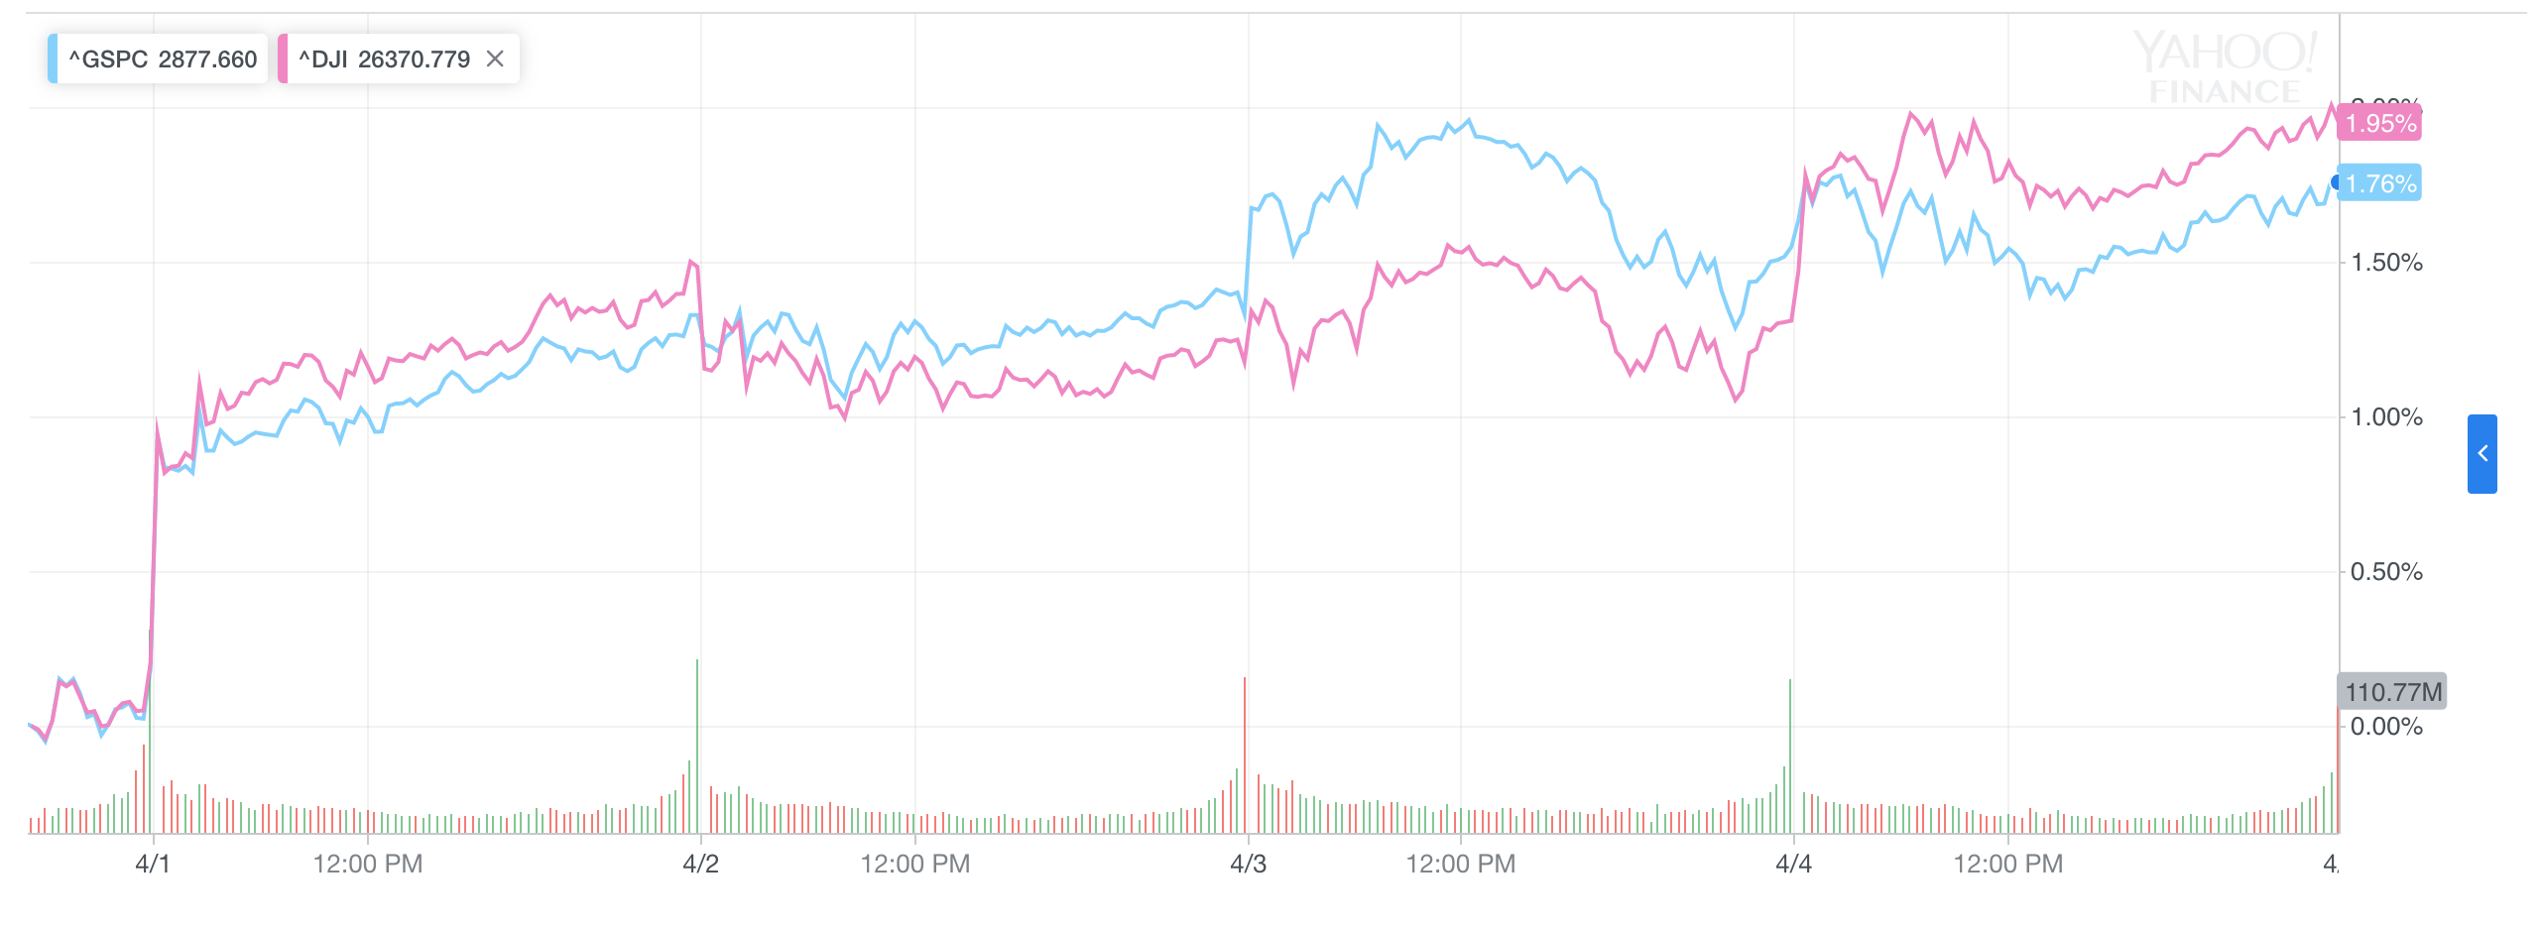
Stock Market Weekly Performance in U.S

Slide 9
Links
https://www.kitco.com/news/2019-04-04/Gold-Throws-Platinum-a-Life-Line.html
https://www.bbc.com/news/uk-politics-47821646
https://www.marketwatch.com/story/us-manufacturing-rebounds-in-march-ism-
index-shows-2019-04-01
https://www.marketwatch.com/story/german-manufacturing-implosion-sends-europe-
stocks-lower-2019-04-04?siteid=yhoof2&yptr=yahoo

